Slide 1
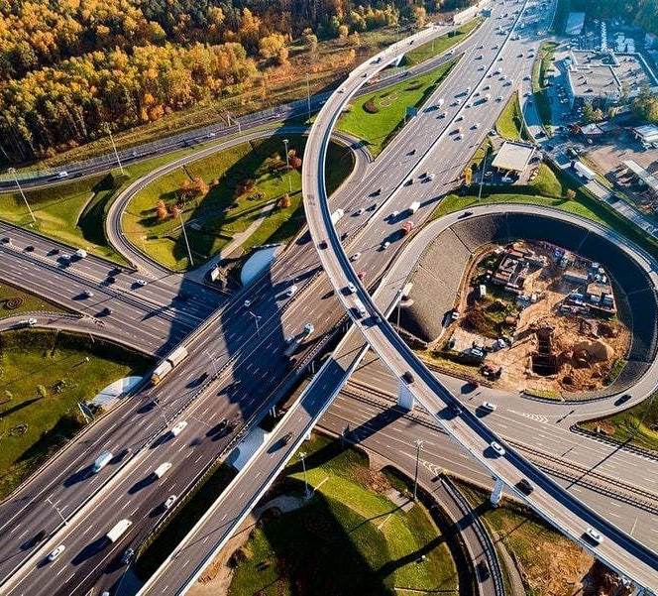
Road Accidents In United States
TEAM 7
SINDHUJA PULYALA
YAMINI Mangarai
SRAVANTHI mANDAVA
MOUNIKA VEMULA
SAI BHARATHI DURGA GUNTUPALLI

Slide 2
Introduction
Million car accidents occur on average in the US each year. with more than 90 deaths occurring each day. Also, 2 million of the 3 million persons who are injured in car accidents each year in the US get lasting damage. In light of all these alarming facts, we decided to research road accidents in the US.
We are trying to describe several examples of traffic collisions, examine the reasons why they happen, and examine the impact of traffic calming measures.
To raise awareness of this significant issue, throw light on it, and improve public transit.
This will enable to suggest ways to improve safety precautions and lower road accidents.

Slide 3

Dataset & Visual Analysis
States of the US
3.5 million records
1.5 millions of records that indicates occurrence of accidents across country.
Accident Hotspot locations
Casuality Analysis
Top 10 states with High traffic accidents rate
Traffic accidents rate over TIME
Exploring the factors

Slide 4
Factors
Automobile Defects
Road Hazards
Speeding
Climate Conditions
Distracted Driving
Neglecting Traffic Rules

Slide 5

Conclusion
Safer Roads ~Addressing the governments: Maintenance of roads ,traffic signals and traffic signs.
Safer Vehicles~ Suggestions to Automobile industry about automatic speed sensors, headlights, seatbelts, airbags and Tires.
Safer Speed Limit~ Traffic safety division of every state to regulate the speed of drivers.
Better Post-Crash Care~ Health, Accident and Automobile insurers to identify the severity of the cases :Better insurance plans or products to be designed to overcome the losses.

Slide 6
References
Dataset - US Accidents- Dataset
https://arxiv.org/abs/1906.05409
https://arxiv.org/abs/1909.09638
https://public.tableau.com/app/profile/bachir.el.hamal/viz/US_Accidents_Project__Bachir/FinalStory

Slide 7
THANK YOU

